Slide 1
EXECUTIVE REPORT | SURVIVAL ANALYSIS
Executive Summary
1,470
Employees analyzed
16.1%
Historical attrition rate
1,233
Active & scored for risk
0.846
Test concordance index
MODEL VALIDATION
HEADLINE FINDINGS
Concordance 0.849 train / 0.846 test — strong ranking power.
Final model refit on all 1,470 employees after validation.
Proportional-hazards assumption checked per covariate (notebook STEP 05).
Strongest driver: Over Time — hazard ×2.20.
Top at-risk employee: ID 2021 — 25% predicted chance of leaving within a year.
Top 15 at-risk employees identified for immediate action.
Cox Proportional Hazards Model | Employee Attrition Analysis
01

Slide 2
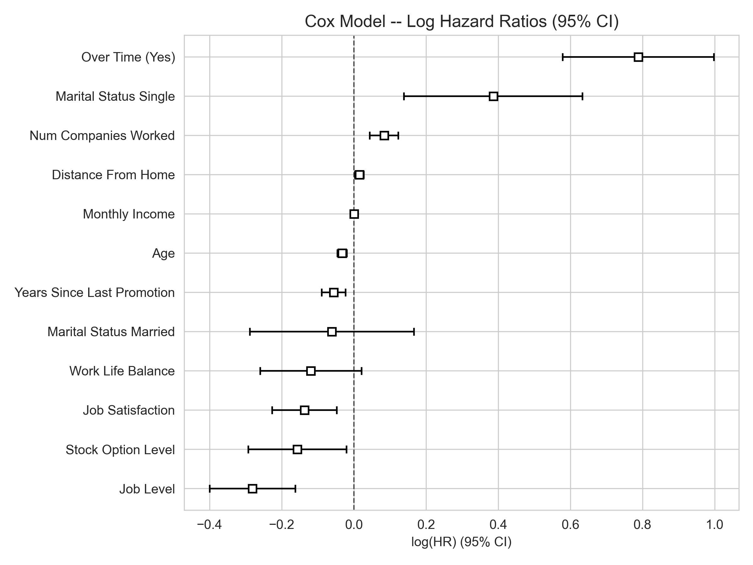
EXECUTIVE REPORT | SURVIVAL ANALYSIS
What Drives Attrition
COEFFICIENT PLOT
HAZARD RATIOS
Over Time (Yes)
×2.20 hazard · p = 0.000
Num Companies Worked
×1.09 hazard · p = 0.000
Monthly Income
×1.00 hazard · p = 0.000
Years Since Last Promotion
×0.95 hazard · p = 0.001
Age
×0.97 hazard · p = 0.000
Job Level
×0.75 hazard · p = 0.000
Hazard ratio above 1.0 raises resignation risk; below 1.0 lowers it. All drivers significant at p < 0.01.
Cox Proportional Hazards Model | Employee Attrition Analysis
02

Slide 3
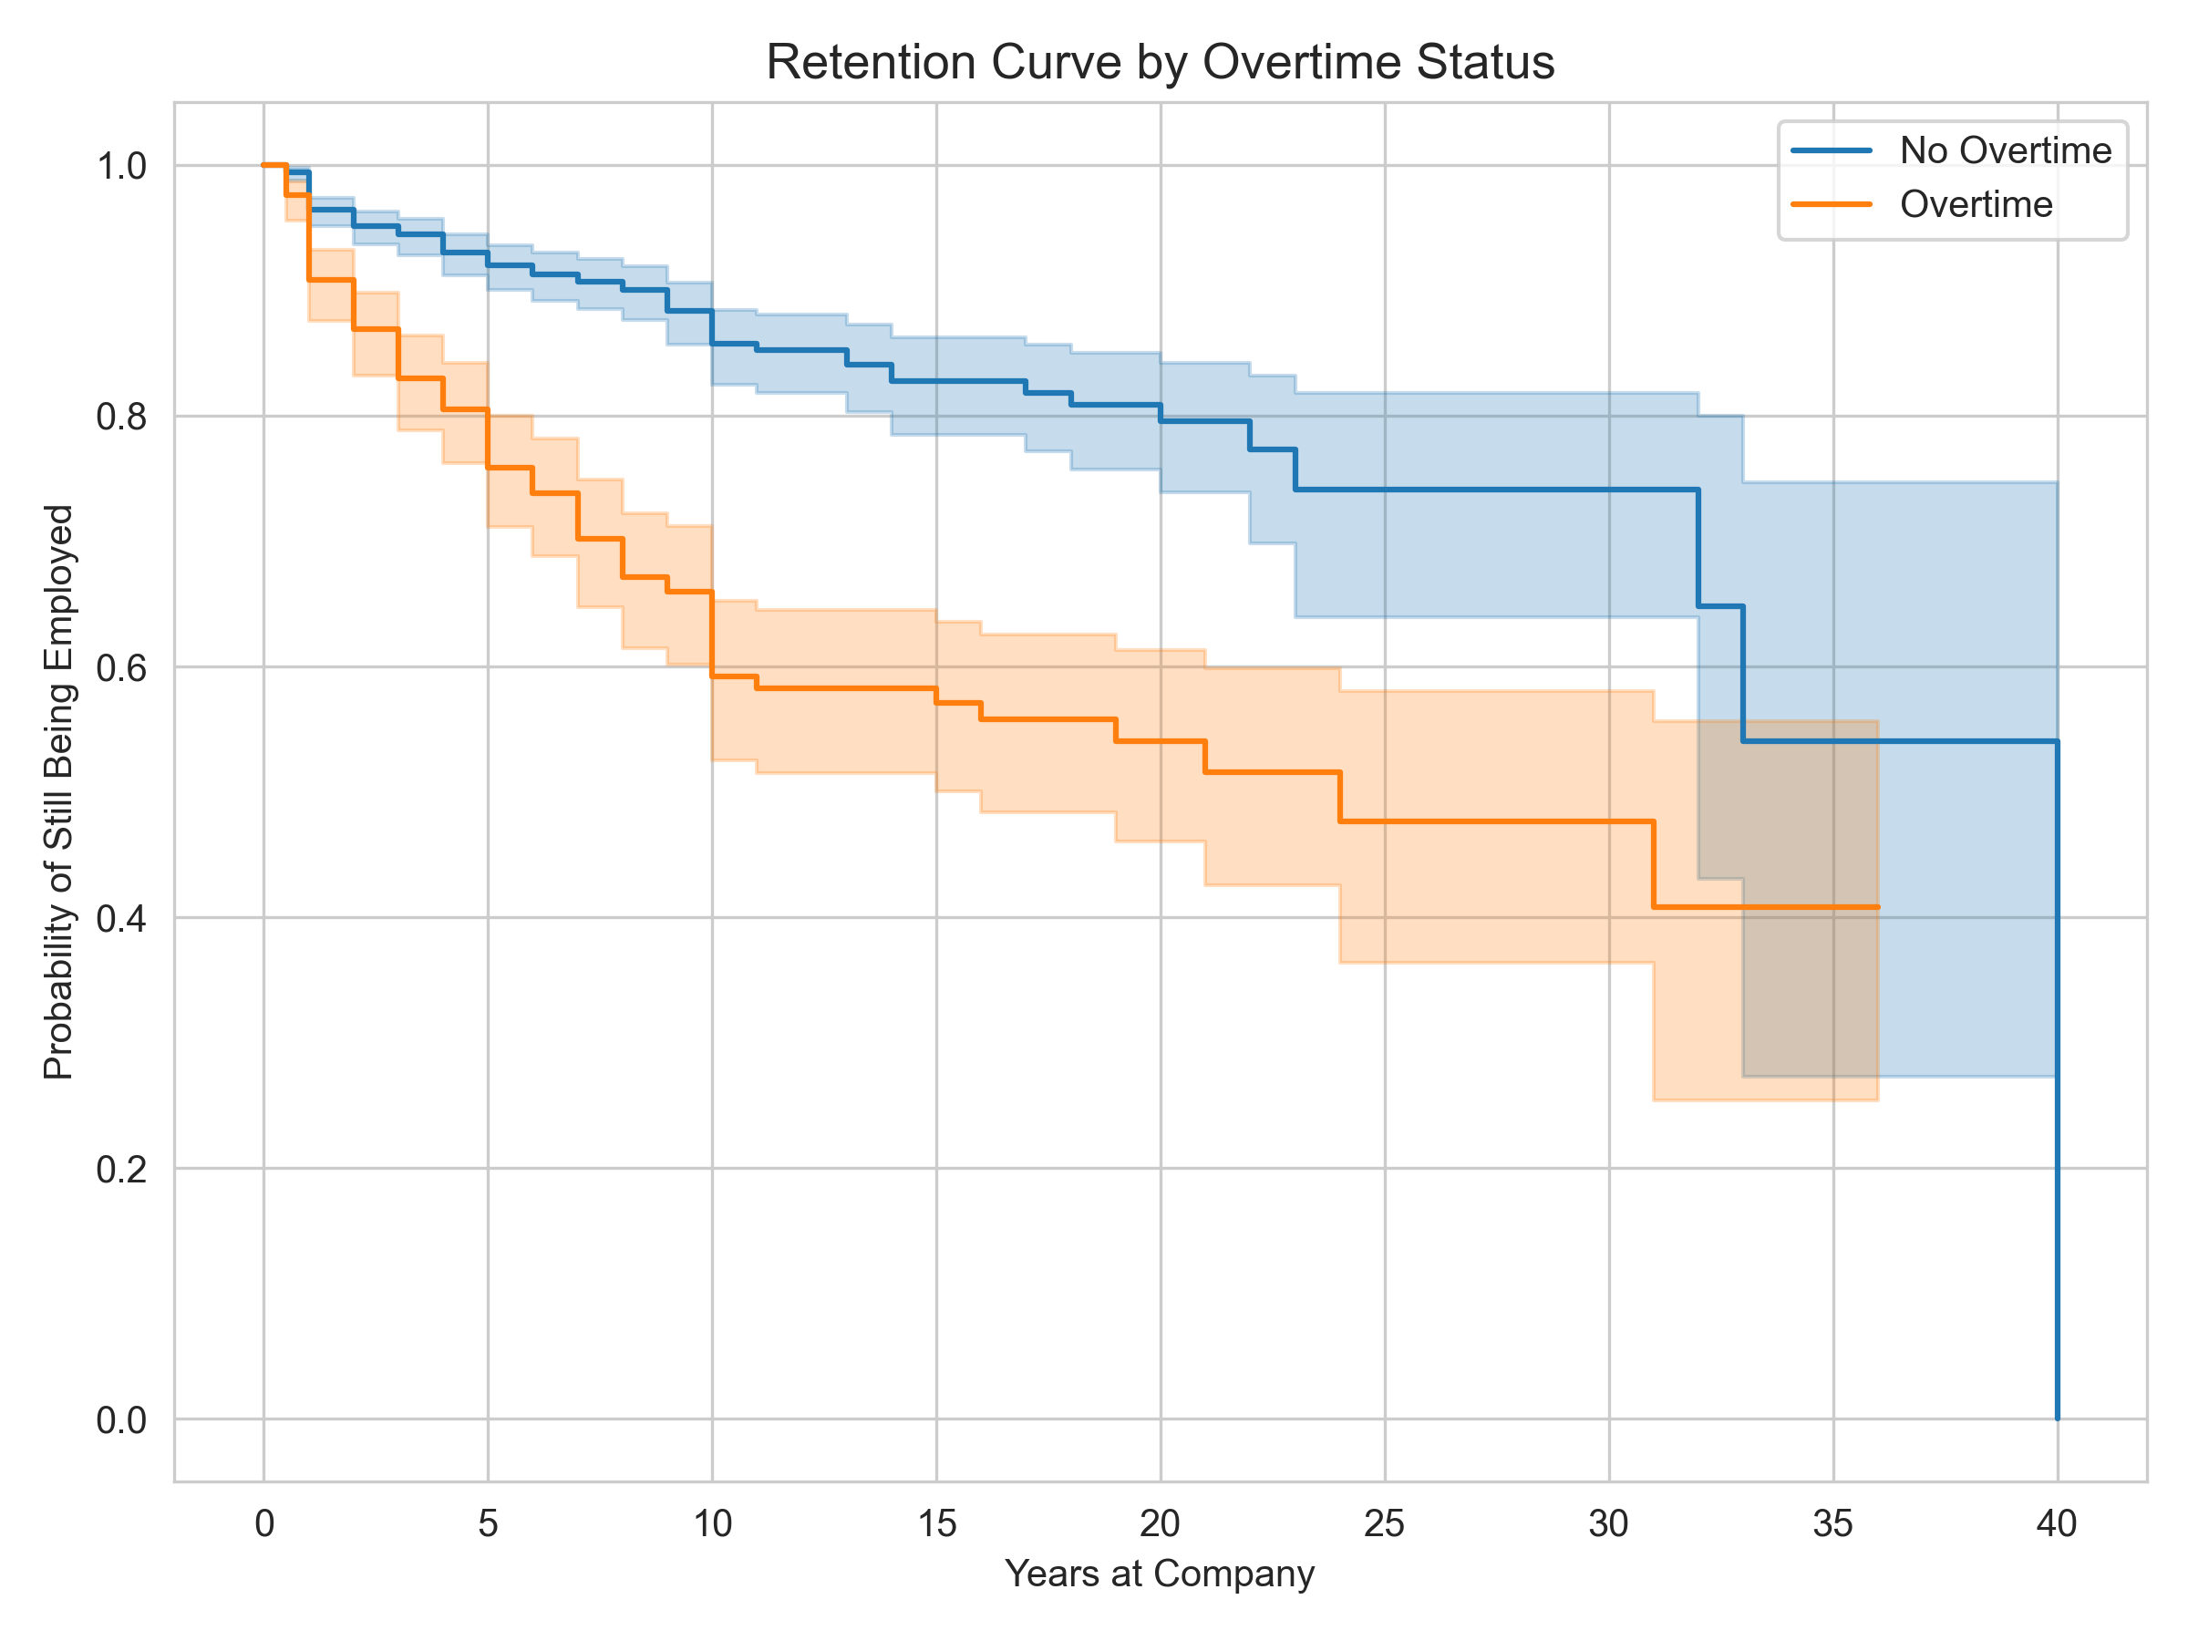
EXECUTIVE REPORT | SURVIVAL ANALYSIS
Retention by Overtime Status
KAPLAN–MEIER SURVIVAL CURVES
SIGNIFICANCE TEST
p = 1.6e-19
Log-rank test — the retention gap between overtime and non-overtime staff is statistically significant.
SO WHAT
Overtime is the single most directly actionable factor found in the model.
Curves show the share of employees still retained over tenure, split by overtime status.
Cox Proportional Hazards Model | Employee Attrition Analysis
03

Slide 4
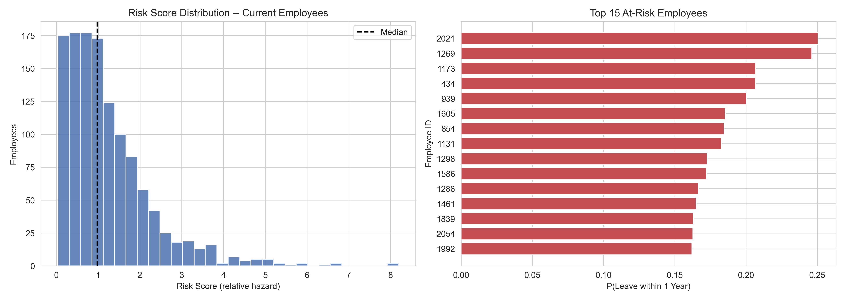
EXECUTIVE REPORT | SURVIVAL ANALYSIS
Who Is at Risk Right Now
TOP 15 EMPLOYEES BY 1-YEAR LEAVE PROBABILITY
1,233
Current employees scored
8.19
Highest risk score vs. median 0.98
NEXT STEP
Open retention conversations with the 15 employees listed above.
Cox Proportional Hazards Model | Employee Attrition Analysis
04

Slide 5
EXECUTIVE REPORT | SURVIVAL ANALYSIS
Recommendations
PRIORITY ACTION
Prioritize retention conversations with the top 15 employees flagged above.
KEY HAZARD DRIVERS
RISK
Over Time (Yes)
Raises hazard by 120% — the single largest driver of attrition.
RISK
Num Companies Worked
Raises hazard by 9% for each prior employer.
PROTECTIVE
Job Level
Lowers hazard by 25% per level of seniority.
PROTECTIVE
Age
Lowers hazard by 3% per additional year.
Cox Proportional Hazards Model | Employee Attrition Analysis
05

